Slide 1

Classifying Amazon Reviews: Fake or Genuine?
CS-513 : Knowledge Discovery & Data Mining

Slide 2




The Team
Saish Sankhe Maithili Deshmukh Hiloni Mehta Vyom Shah

Slide 3
Introduction
There are so many reviews out there and it is often hard to understand which reviews are genuine or fake.
It is very hard to figure which product is the best as there are tons of fake reviews
Hence, we came up with the solution to detect the fake reviews, that can help customers to identify the best product.
HAPPY SHOPPING!

Slide 4
Description about the dataset
A text file with 21000 rows and 9 columns
Amazon Reviews : https://www.kaggle.com/lievgarcia/amazon-reviews#amazon_reviews.txt

Slide 5
Exploratory data analysis
Total number or rows:
Fake and Genuine review distribution:
Total columns, before data processing:
Total columns, after data processing:

Slide 6
Exploratory data analysis
Column names, before data processing:
Derived columns:

Slide 7
Verified Purchase Total words in review text

Slide 8
Total sentences Total punctuations

Slide 9
Total stop words Total characters in
review title

Slide 10
Models that we have used
Knn
Random Forest
CART
K-means
Naïve Bayes
SVM

Slide 11
1. knn
The KNN algorithm has the following features:
KNN is a Supervised Learning algorithm that uses labelled input data set to predict the output of the data points.
It is one of the most simple Machine learning algorithms and it can be easily implemented for a varied set of problems.
It is mainly based on feature similarity. KNN checks how similar a data point is to its neighbour and classifies the data point into the class it is most similar to.

Slide 12
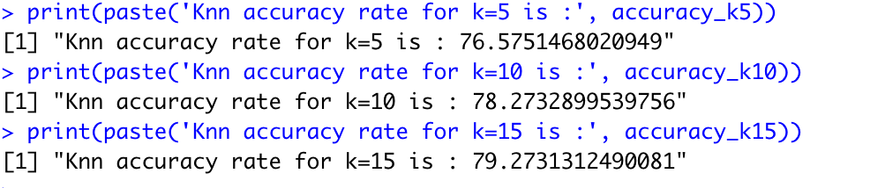
knn
We got max accuracy for k=15
Using the elbow rule, k=10 is the best fit

Slide 13
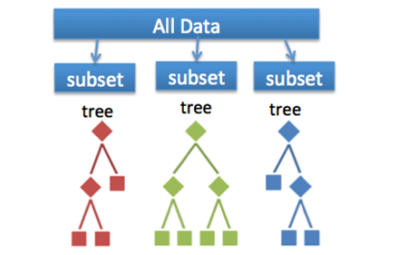
2. Random Forest
Random forest algorithm is a supervised classification and regression algorithm. This algorithm randomly creates a forest with several trees.
Generally, the more trees in the forest the more robust the forest looks like. Similarly, in the random forest classifier, the higher the number of trees in the forest, greater is the accuracy of the results.

Slide 14
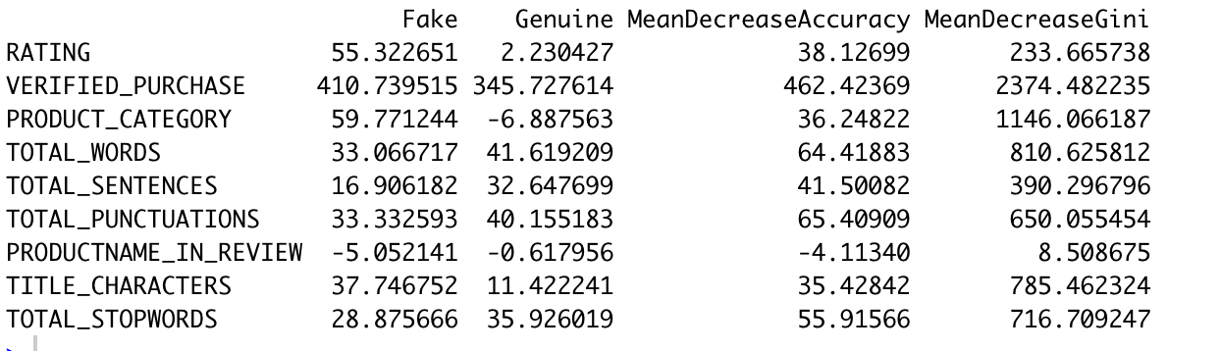
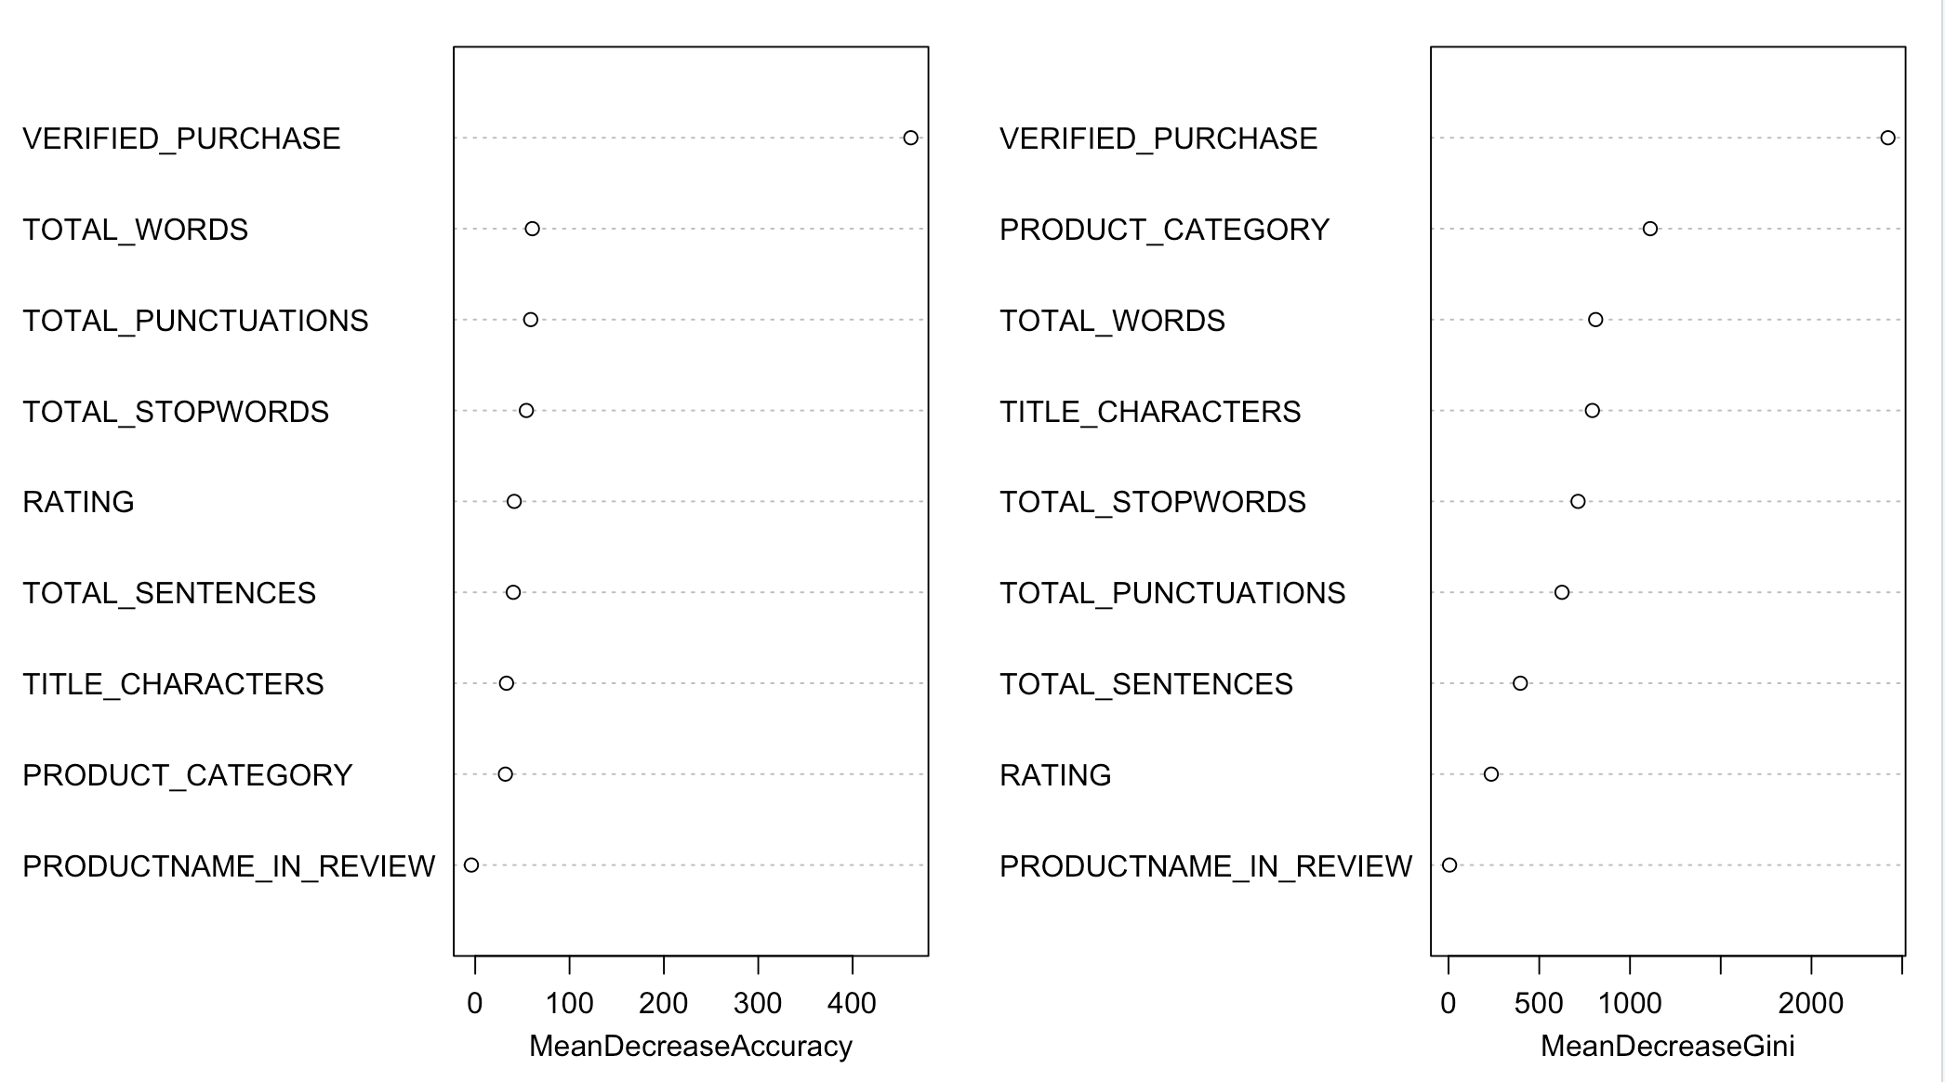
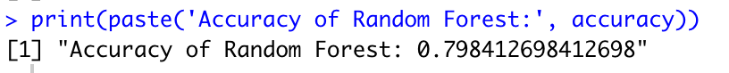
Random Forest
Verified purchased is the most important factor

Slide 15
3.CART
The decision tree method is a powerful and popular predictive machine learning technique that is used for both classification and regression. So, it is also known as Classification and Regression Trees (CART).
The algorithm of decision tree models works by repeatedly partitioning the data into multiple sub-spaces, so that the outcomes in each final sub-space is as homogeneous as possible. This approach is technically called recursive partitioning.

Slide 16
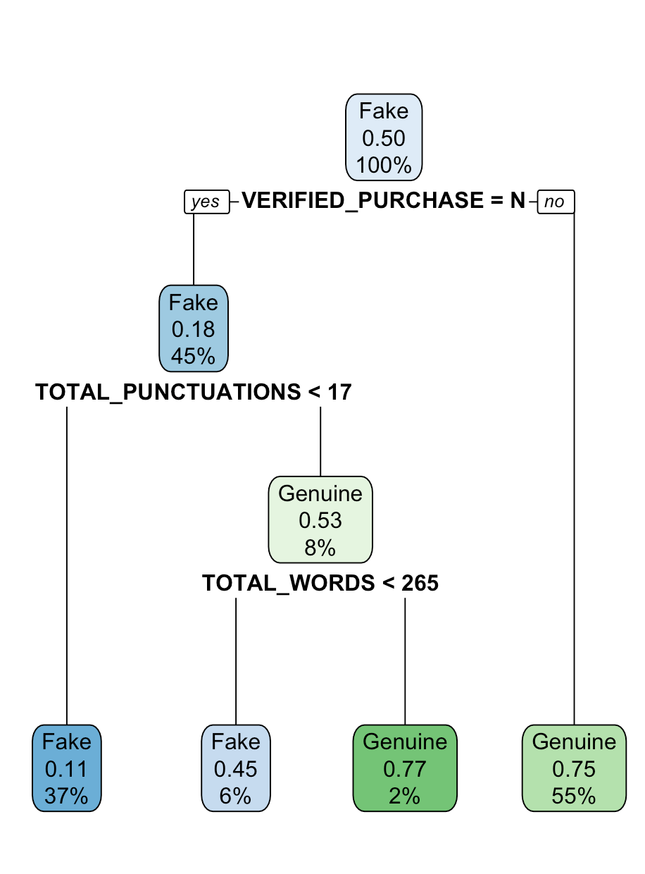
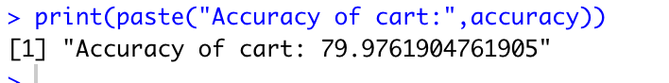
CART
CART ACCURACY: ~80%

Slide 17
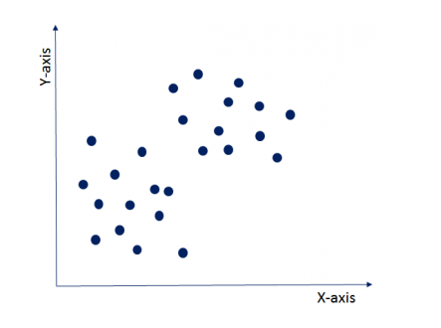
4. k-means
k-means clustering is one of the simplest algorithms which uses unsupervised learning method to solve known clustering issues. k-means clustering require following two inputs.
k = number of clusters
Training set(m) = {x1, x2, x3,……….., xm}

Slide 18
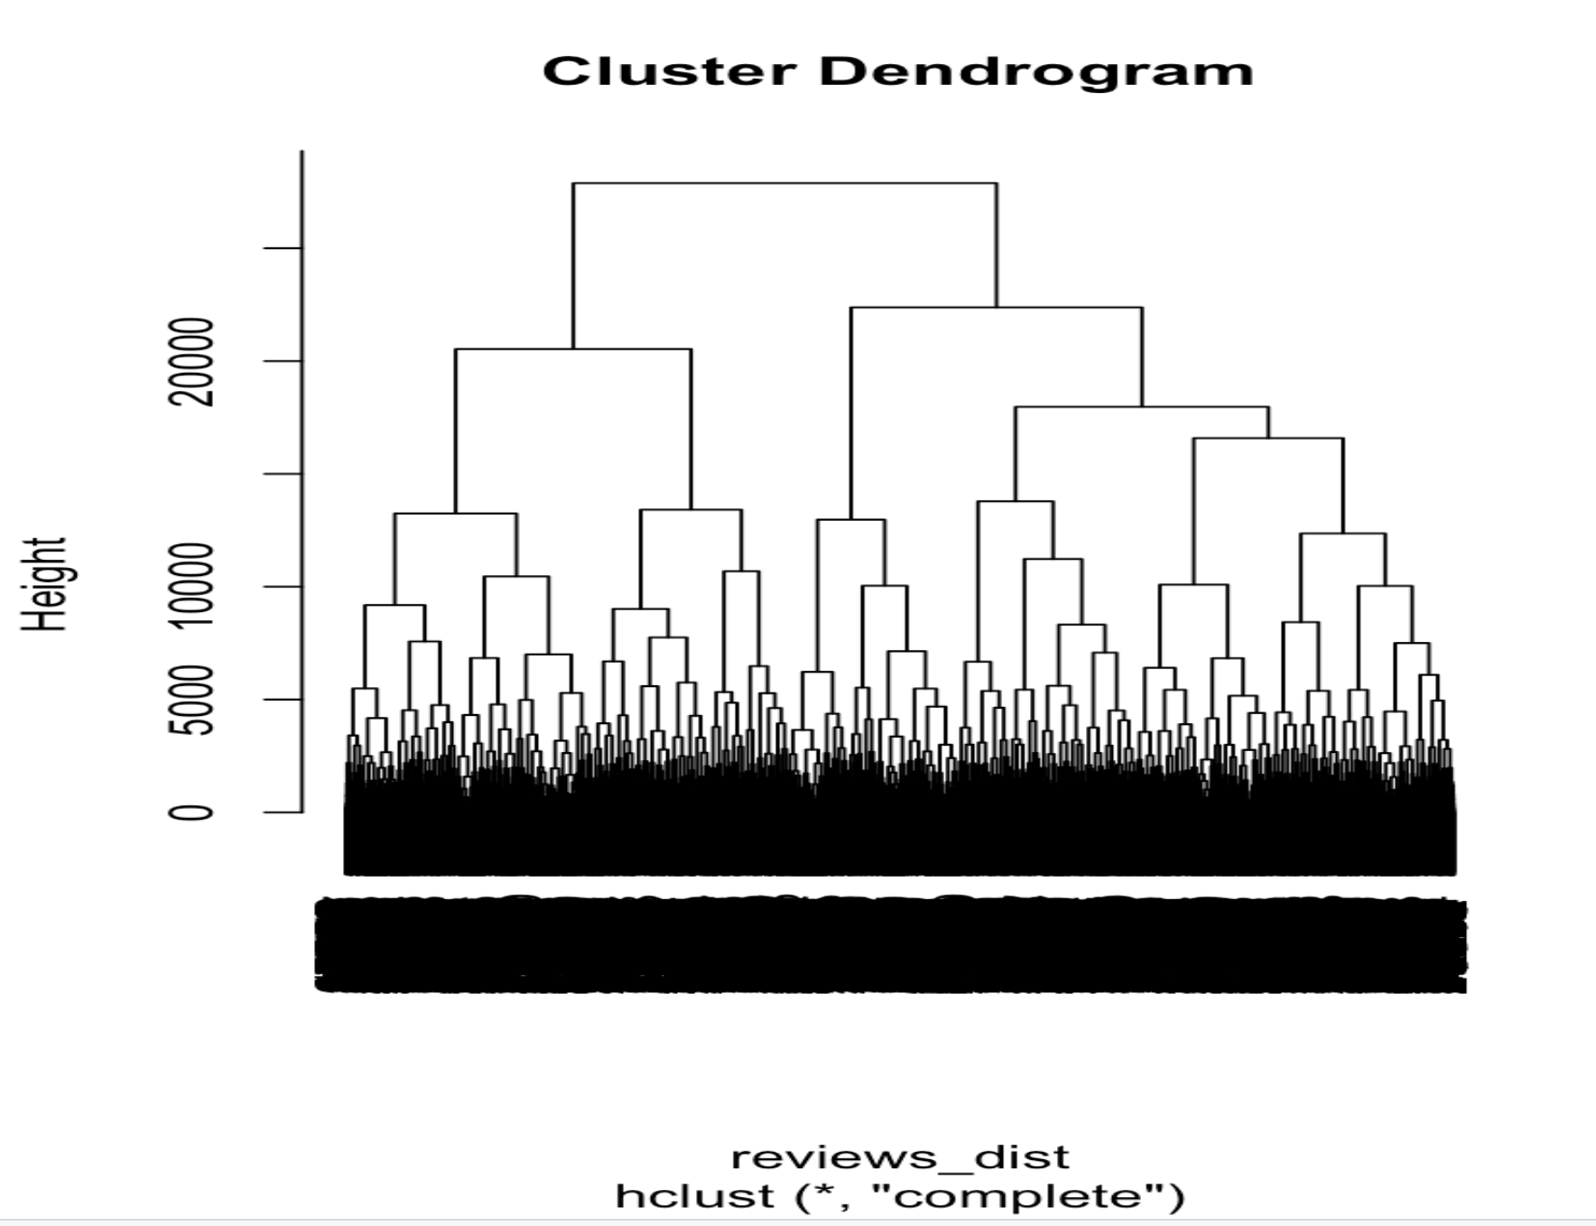
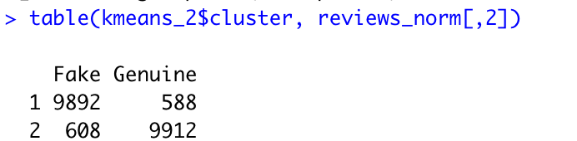
Kmeans

Slide 19
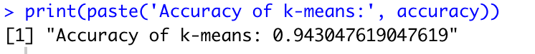
k-means

Slide 20
5. Naïve Bayes
Naive Bayes is a Supervised Machine Learning algorithm based on the Bayes Theorem that is used to solve classification problems by following a probabilistic approach. It is based on the idea that the predictor variables in a Machine Learning model are independent of each other. Meaning that the outcome of a model depends on a set of independent variables that have nothing to do with each other.

Slide 21
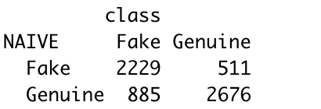
Naïve Bayes
Table
Accuracy

Slide 22
6. SVM
SVM (Support Vector Machine) is a supervised machine learning algorithm which is mainly used to classify data into different classes
SVM can be used to generate multiple separating hyperplanes such that the data is divided into segments and each segment contains only one kind of data.

Slide 23
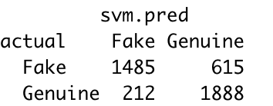
SVM
SVM table
Accuracy

Slide 24
Comparison

Slide 25
Future Scope
We can consider other characteristics such as:
Lemmatization
Stemming
Timestamp of reviews
Corresponding user data

Slide 26
Conclusion
K- Means algorithm gives the best accuracy that is 94.30%

Slide 27
THANK YOU

